Slide 1

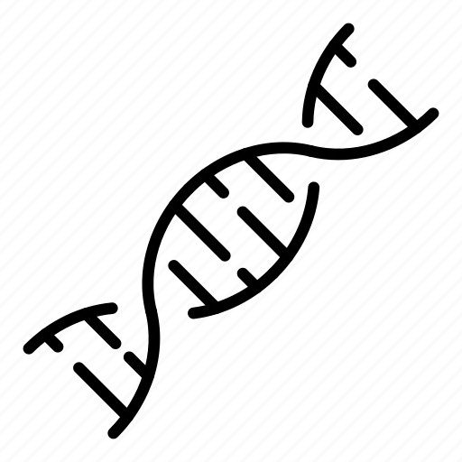

Human Single-Cell Classification

Slide 2
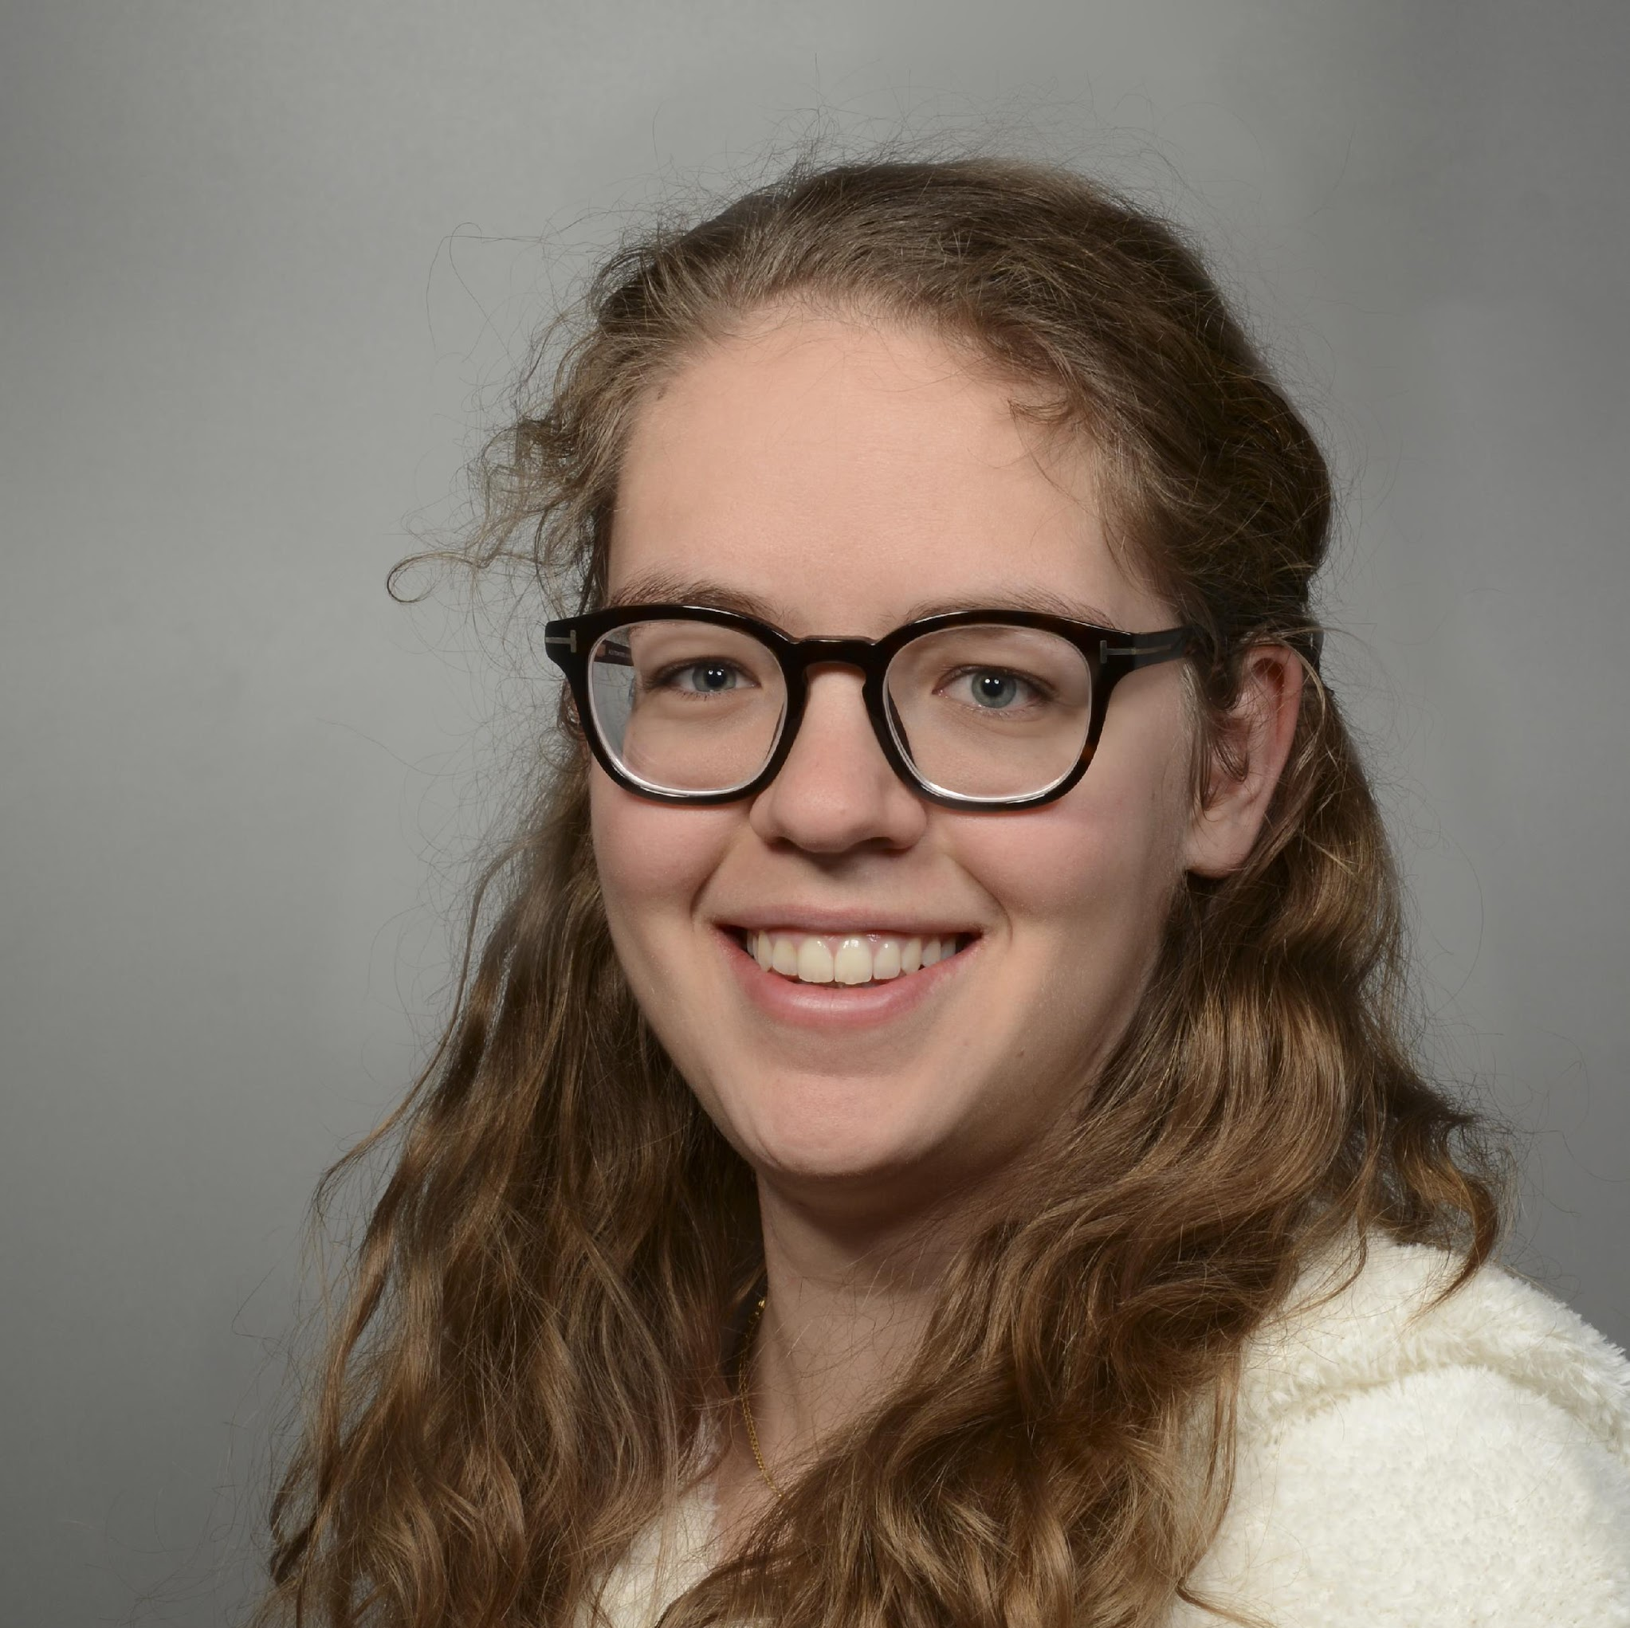
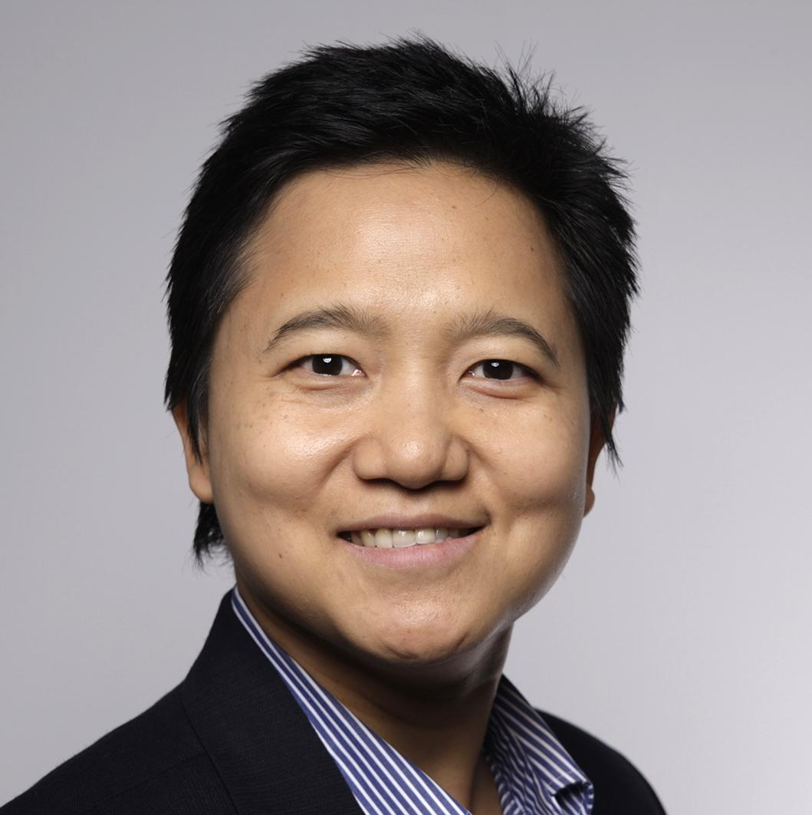
Martina Trippel
Peerawan Wiwattananon
MSc. Biology: Genetics and Development,
University of Zürich
Ph.D. in Aerospace Engineering, TU-Delft.
NASA, CERN, RUAG Space Experience.
Specialization High Technology Product Development and Project Management
Notes:
Martina: I am a Biologist and I am specialized in Genetics and Development.
Nat: I am a technologist and I am specialized in high technology product development and project management.

Slide 3


Transform the horizon of treatment options.
Discover innovative medicines.
Develop innovative medicines.
Commercialize innovative medicines.
Drugs in the pipelines: Insomnia disease, Fabry disease.
Notes:
Idorsia Pharmaceuticals is working on transforming the horizon of treatment options but disco

Slide 4








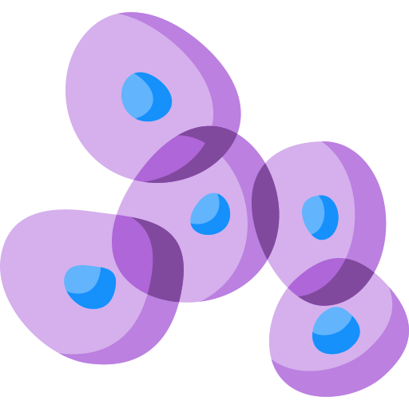



Business Problem: Cell Classification in Tumors
Cells
Classification Tool
Classification
Pre-Treatment
Treatment
Classification
Post-Treatment
Comparison
Notes:
Why do we do single-cell classifications? What information do we get out of this classification? How can we use these information to develop drugs?
Why is it so important to do single-cell classifications?
When there are tumor cells, immune cells infiltrate into the tumor cells to kill them. And In order to investigate drug performances to cure cancers, it is crucial to have a tool to classify immune cells that infiltrate the tumor.
This tool can compare cells inside the tumor before and after the drug treatment.
The procedures to classify cells can be done at the Microenvironment of the tumor. It starts with cell classifications, then the patients are treated then cells are classify again to understand differences before and after the treatment. Then the patients are treated again and cell classifications cycle keeps going.
The outcome of this project can be used by Idosria as one tool to develop drugs to cure cancers.

Slide 5
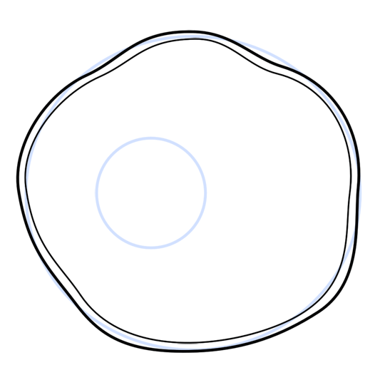

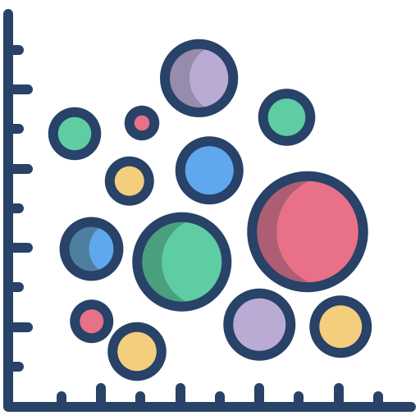

Background
Gen A
Gen B
Gen C
Cell Type X
Cell Type Y
Classification
Genes
3’000 Genes
Notes:
All cells contain the same genes. However, each cell type shows a different activity of those genes. This gene activity can be measured and since it is specific for each cell type it can be used to assign cell to their cell types.
From different scientific papers Idorsia put together a dataset with over 100’000 cells and the activity of 3’000 genes for each of those cells. With this dataset we were able to build a tool to classify the cells
Two tasks were given to us: first make a model to classify the cell types and then extract genes that are driving each cell types
Used machine learning for this
Gene expression count as input
Output will be classification
Model also gives us genes that are specific to cell types by calculation importance of each gene for classifying each cell type

Slide 6
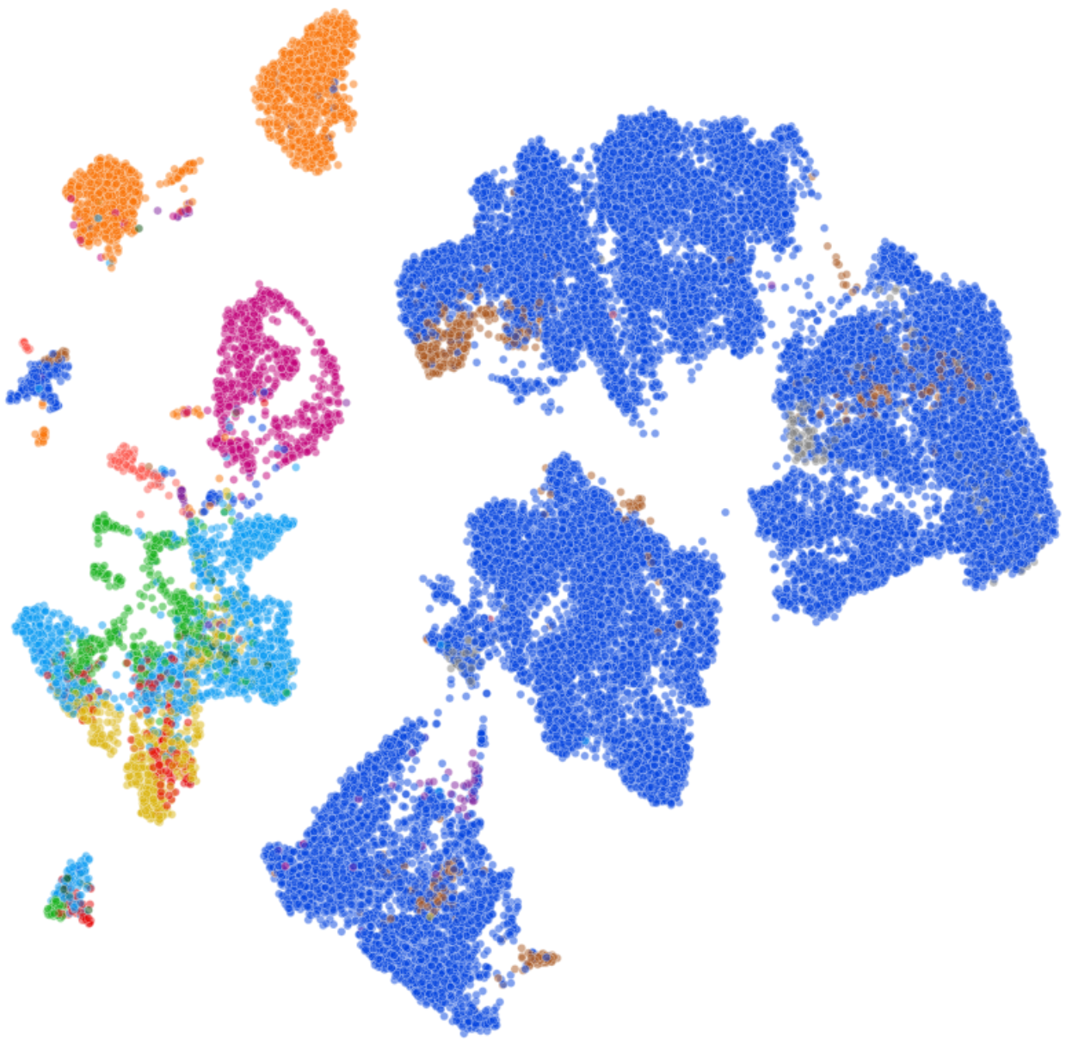
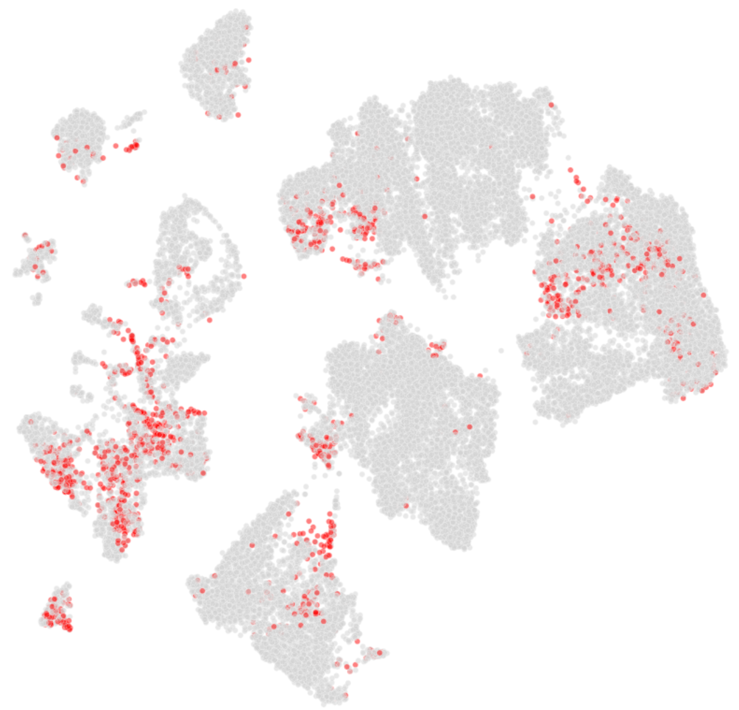
96% of the cells were correctly classified
Real
Predicted
B-Cell
T-Cell
False
True
Notes:
12 Classes : prediction accuracy is 96%
12 Classes: Macro F1: 74%
Projection of the activity of 3’000 genes into 2 dimensions so that we can see it
On the left you can see the cell clusters coloured by the actual cell types
On the right we have the same cell clusters again but this time the cells that our model didn’t predict correctly are coloured in red.
With an accuracy of 96% the prediction performs very well especially for the major cell types like the blue ones in the picture on the left.
However, there are still some inconsistencies between the actual and predicted results for minorities cell types.

Slide 7
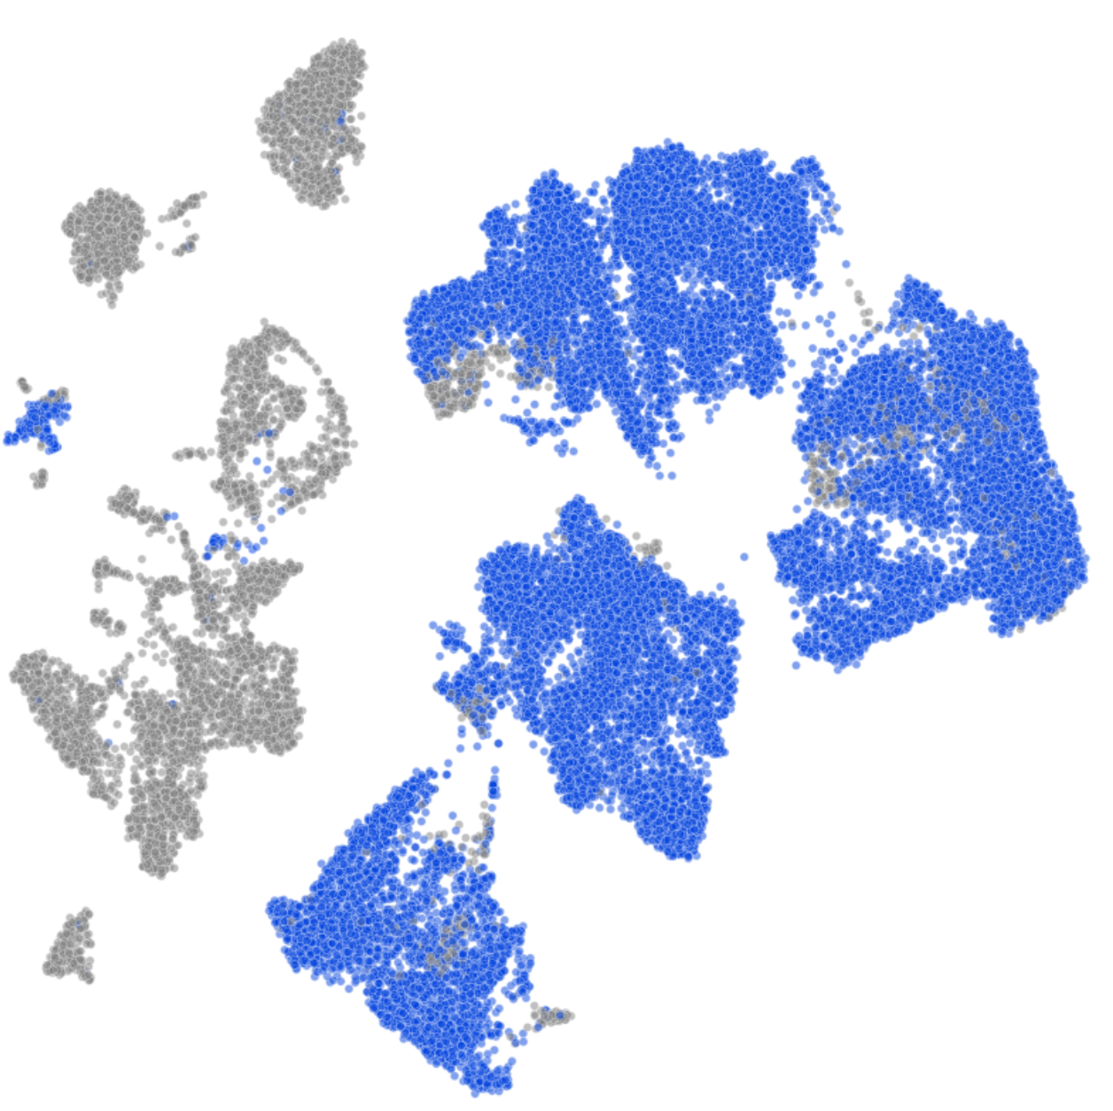
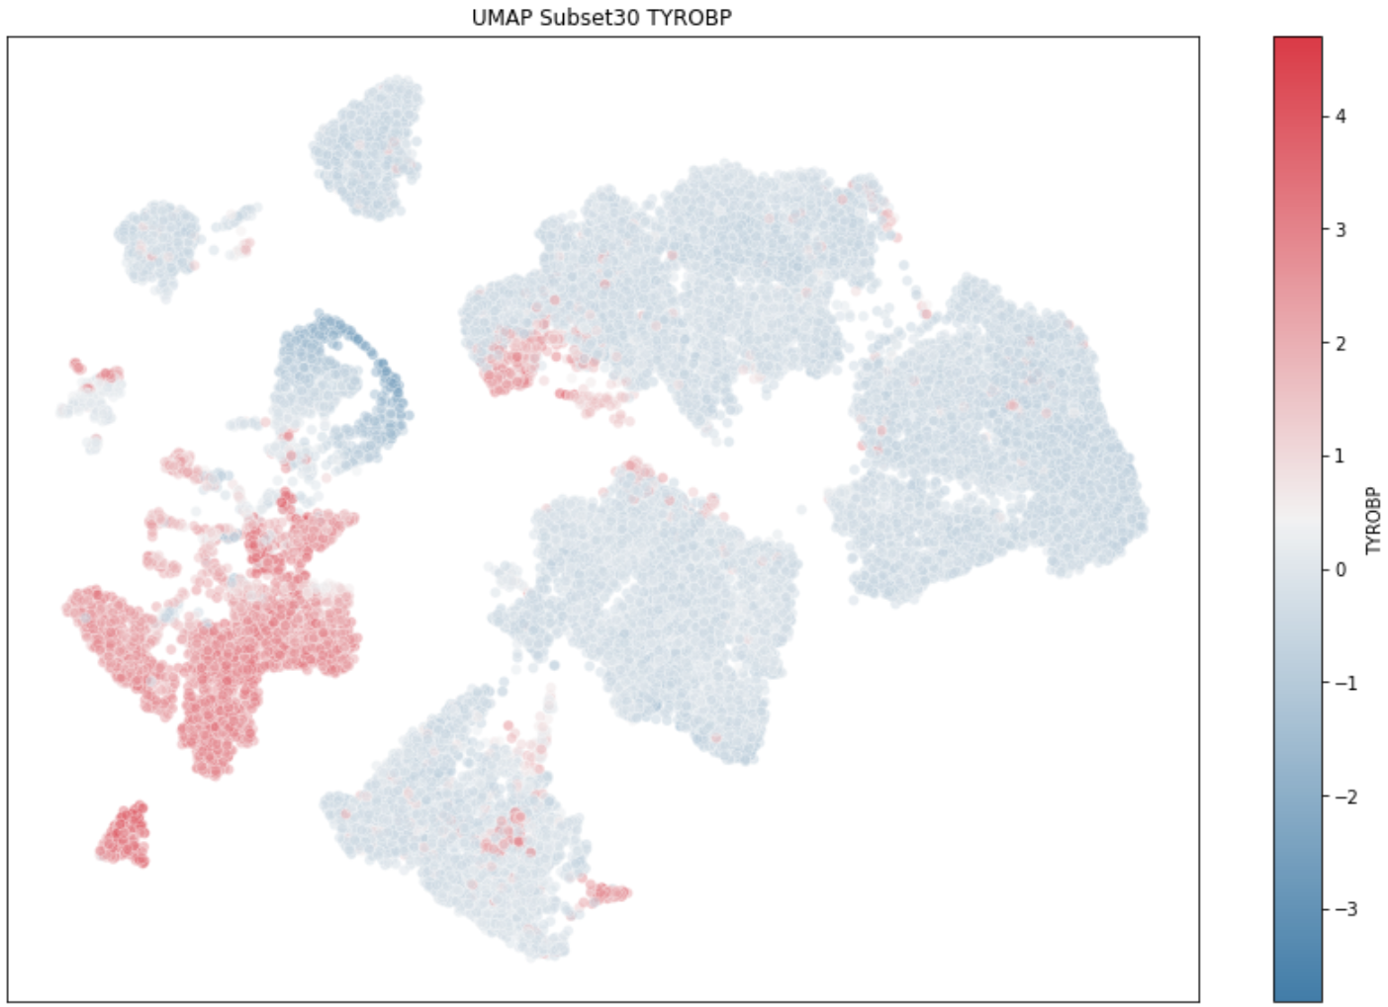
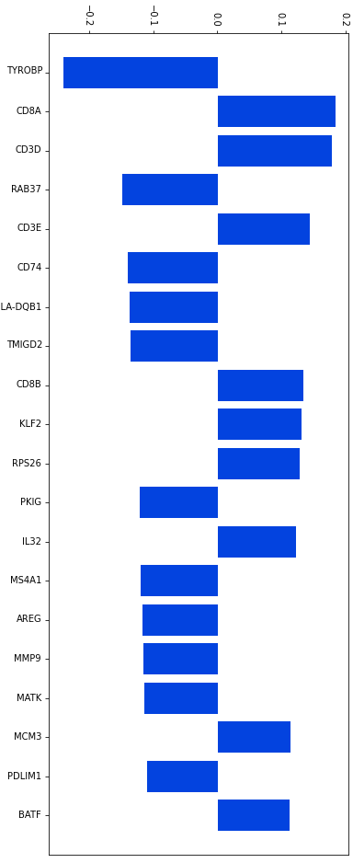
Important Genes for T-Cells
T-Cell Genes
-0.2
-0.1
0
0.1
0.2
High
TYROBP Gene
T-Cell
T-Cell
Other Cell
Low
Notes:
Example of

Slide 8
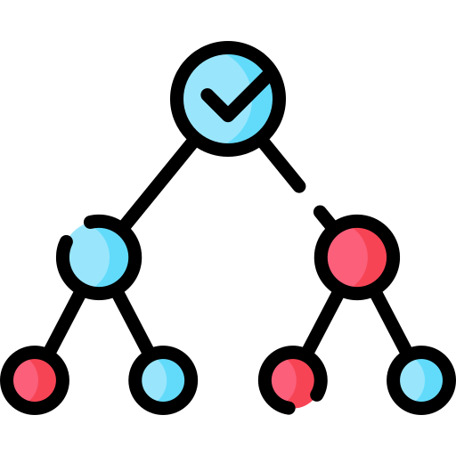


Outlook
Simpler model with most significant genes
Applications to drug development at Idorsia Pharmaceuticals Ltd.
Notes:
12 Classes : prediction accuracy is 96%
12 Classes: Macro F1: 74%
Here you can see a comparison between the actual cell types and the cell types that our model predicted. As you can see the prediction performs very well for the major cell types, however, there are still some inconsistencies between the actual and predicted results for minorities cell types.

Slide 9


martina.trippel@bluewin.ch
nattzza@gmail.com
Martina Trippel | LinkedIn
Dr. Peerawan Wiwattananon | LinkedIn
MSc. Biology: Genetics and Development,
University of Zürich
NASA, CERN, RUAG Space Experience.
Specialization High Technology Product Development and Project Management
Notes:
Lastly, Thank you for your participation and interests in our project. We are happy to answer your questions and hope we can collaborate with you in the future. Here are our contact details.

